Slide 1
CSC371-Database Systems I Lecture-10(Lab) (Fall2023)

Slide 2
Previous Lecture Review
SQL Group By Clause
SQL Having Clause
SQL Views

Slide 3
CREATE TABLE Branch(
branchNo VARCHAR(15) NOT NULL,
street VARCHAR(20) NOT NULL,
city VARCHAR(20) NOT NULL,
postcode VARCHAR(15) NOT NULL,
CONSTRAINT pk_branches PRIMARY KEY(branchNo)
);
CREATE TABLE Staff(
staffNo VARCHAR(10) NOT NULL
fName VARCHAR(15) NOT NULL,
lName VARCHAR(15) NOT NULL,
position VARCHAR(15) NOT NULL,
sex VARCHAR(15) NOT NULL,
DOB DATE NOT NULL,
salary INT(15) NOT NULL,
branchNo VARCHAR(15) NOT NULL,
CONSTRAINT pk_staffs PRIMARY KEY(staffNo),
CONSTRAINT fk_staffs FOREIGN KEY(branchNO) REFERENCES Branch(branchNo)
);

Slide 4
CREATE TABLE PrivateOwner(
ownerNo VARCHAR(15) NOT NULL,
fName VARCHAR(15) NOT NULL,
lName VARCHAR(15) NULL,
address VARCHAR(50) NOT NULL,
telNo VARCHAR(15) NOT NULL,
eMail VARCHAR(20) NOT NULL,
CONSTRAINT pk_privateOwners PRIMARY KEY(ownerNo)
);

Slide 5
CREATE TABLE PropertyForRent(
propertyNo VARCHAR(15) NOT NULL,
street VARCHAR(20) NOT NULL,
city VARCHAR(20) NULL,
postcode VARCHAR(15) NOT NULL,
TYPE VARCHAR(15) NOT NULL,
rooms INT NOT NULL,
rent INT NOT NULL,
ownerNo VARCHAR(15) NOT NULL,
staffNo VARCHAR(15) NULL,
branchNo VARCHAR(10) NOT NULL,
CONSTRAINT pk_propertyForRents PRIMARY KEY(propertyNo),
CONSTRAINT fk_propertyForRents FOREIGN KEY(ownerNO) REFERENCES PrivateOwner(ownerNo),
CONSTRAINT fk_property FOREIGN KEY(staffNo) REFERENCES Staff(staffNo),
CONSTRAINT fk_for FOREIGN KEY(branchNo) REFERENCES Branch(branchNo)
);

Slide 6
INSERT INTO Branch VALUES ('B005', '22 Deer Rd', 'London', 'SW1 4EH');
INSERT INTO Branch VALUES ('B007', '16 Argyll St', 'Aberdeen', 'AB2 3SU');
INSERT INTO Branch VALUES ('B003', '163 Main St', 'Glasgow', 'G11 9QX');
INSERT INTO Branch VALUES ('B004', '32 Manse Rd', 'Bristol', 'BS99 1NZ');
INSERT INTO Branch VALUES ('B002', '56 Clover Dr', 'London', 'NW10 6EU');
INSERT INTO Staff VALUES ('SL21', 'John', 'White','Manager', 'M', '1945-10-01', 30000, 'B005');
INSERT INTO Staff VALUES ('SG37', 'Ann', 'Beech','Assistant', 'F', '1960-10-11', 12000, 'B003');
INSERT INTO Staff VALUES ('SG14', 'David','Ford', 'Supervisor','M', '1958-11-24', 18000, 'B003');
INSERT INTO Staff VALUES ('SA9', 'Mary', 'Howe', 'Assistant', 'F', '1970-02-19', 9000, 'B007');
INSERT INTO Staff VALUES ('SG5', 'Susan','Brand','Manager', 'F', '1940-06-03', 24000, 'B003');
INSERT INTO Staff VALUES ('SL41', 'Julie','Lee', 'Assistant', 'F', '1965-06-13', 9000, 'B005');

Slide 7
INSERT INTO PrivateOwner VALUES ('CO46', 'Joe', 'Keogh', '2 Fergus Dr, Aberdeen AB2 7SX','01224-861212' ,'jkeogh@lhh.com');
INSERT INTO PrivateOwner VALUES ('CO87', 'Carol','Farrel','6 Achray St, Glasgow G32 9DX', '0141-357-7419','cfarrel@gmail.com');
INSERT INTO PrivateOwner VALUES ('CO40', 'Tina', 'Murphy','63 Well St, Glasgow G42', '0141-943-1728','tinam@hotmail.com');
INSERT INTO PrivateOwner VALUES ('CO93', 'Tony', 'Shaw', '12 Park Pl, Glasgow G4 0QR', '0141-225-7025','tony.shaw@ark.com');
INSERT INTO PropertyForRent VALUES ('PA14', '16 Holhead', 'Aberdeen', 'AB7 5SU', 'House',6, 650, 'CO46', 'SA9', 'B007');
INSERT INTO PropertyForRent VALUES ('PL94', '6 Argyll St', 'London', 'NW2', 'Flat', 4, 400, 'CO87', 'SL41', 'B005');
INSERT INTO PropertyForRent VALUES ('PG4', '6 Lawrence St','Glasgow', 'G11 9QX', 'Flat', 3, 350, 'CO40', NULL, 'B003');
INSERT INTO PropertyForRent VALUES ('PG36', '2 Manor Rd', 'Glasgow', 'G32 4QX', 'Flat', 3, 375, 'CO93', 'SG37', 'B003');
INSERT INTO PropertyForRent VALUES ('PG21', '18 Dale Rd', 'Glasgow', 'G12', 'House',5, 600, 'CO87', 'SG37', 'B003');
INSERT INTO PropertyForRent VALUES ('PG16', '5 Novar Dr', 'Glasgow', 'G12 9AX', 'Flat', 4, 450, 'CO93', 'SG14', 'B003');

Slide 8
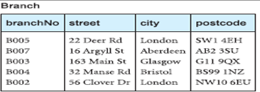
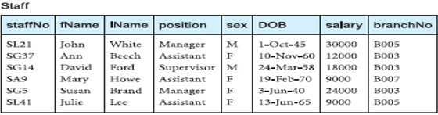
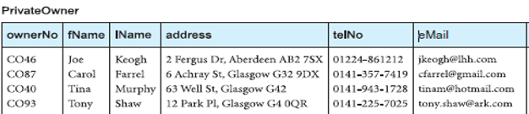
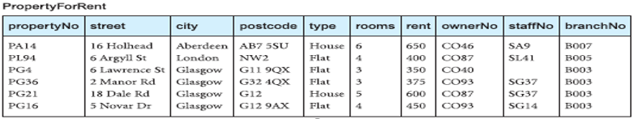

Slide 9
Agenda
SQL Joins

Slide 10
SQL JOIN
Used to combine rows from two or more tables, based on a reference column between them.

Slide 11
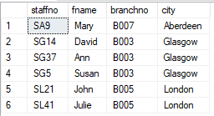
Table Joining using Where Clause
SELECT table1.column, table2.column
FROM table1, table2
WHERE table1.column1 = table2.column2
SELECT Staff.staffno, Staff.fname ,Staff.branchno, Branch.city
FROM Branch, Staff
Where Branch.branchno = Staff.branchno;

Slide 12
Alternative to where for Joining tables
SELECT *
FROM table1 JOIN table2……
[ON (join_condition)]
SELECT Staff.staffno, Staff.fname ,Staff.branchno, Branch.city
FROM Branch join Staff
ON Branch.branchno = Staff.branchno;

Slide 13
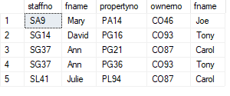
Joining More than Two Tables
select staff.staffno, staff.fname, propertyforrent.propertyno, privateowner.ownerno, privateowner.fname
From Staff,PropertyForRent, PrivateOwner
Where staff.staffno = propertyforrent.staffno
AND propertyforrent.ownerno = privateowner.ownerno;

Slide 14
Joining More than Two Tables Alternative Approach
select staff.staffno, staff.fname, propertyforrent.propertyno, privateowner.ownerno, privateowner.fname
From Staff Join PropertyForRent
ON staff.staffno = propertyforrent.staffno
Join PrivateOwner
ON propertyforrent.ownerno = privateowner.ownerno;

Slide 15
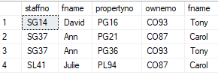
Can add condition
select staff.staffno, staff.fname, propertyforrent.propertyno, privateowner.ownerno, privateowner.fname
From Staff, ProperForRent, PrivateOwner
Where staff.staffno = propertyforrent.staffno
AND propertyforrent.ownerno = privateowner.ownerno
AND Privateowner.fname <> ‘Joe’

Slide 16
Use of Alias with Table name
select S.staffno, S.fname, P.propertyno, O.ownerno, O.fname
From Staff S, ProperForRent P, PrivateOwner O
Where S.staffno = P.staffno
AND P.ownerno = O.ownerno
AND O.fname <> ‘Joe’

Slide 17
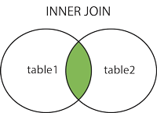
SQL INNER JOIN
The INNER JOIN keyword selects records that have matching values in both tables.
SELECT column_name(s) FROM table1 INNER JOIN table2 ON table1.column_name = table2.column_name;`

Slide 18
SELECT Staff.staffno, Staff.fname ,Staff.branchno, Branch.city
FROM Branch inner join Staff
ON Branch.branchno = Staff.branchno;

Slide 19
We need to retrieve data of staff name their numbers, their city where they are working along with their branch number.
SELECT Staff.staffno, Staff.fname ,Staff.branchno, Branch.city FROM Branch
INNER JOIN Staff
ON Branch.branchno = Staff.branchno;

Slide 20
Join three or more tables
select staff.staffno, staff.fname, propertyforrent.propertyno, privateowner.ownerno, privateowner.fname
From ((Staff
inner join propertyforrent on staff.staffno = propertyforrent.staffno)
inner join privateowner on propertyforrent.ownerno = privateowner.ownerno);

Slide 21
Summary
SQL Joins

